Slide 1
BO101 LECTURE 5
Decoding DNA: understanding genetic code

Slide 2
Nucleic acids
Nucleic acids are biopolymers that participate in STORAGE, TRANSMISSION & TRANSLATION of genetic information
There are 2 types of nucleic acids
Ribose Nucleic Acid (RNA)
Deoxyribose Nucleic Acid (DNA)
Called Nucleic Acid because it was isolated from cell nucleus

Slide 3
Nucleic acids: Two types
DNA: Found ONLY inside the nucleus and STORES genetic information
RNA: Found inside and outside the nucleus and involved in TRANSMISSION & TRANSLATION of genetic information into Proteins

Slide 4
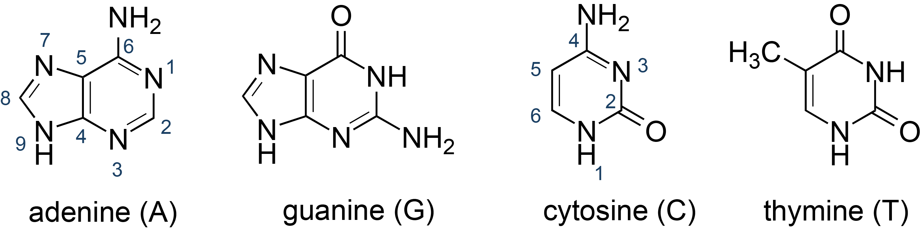
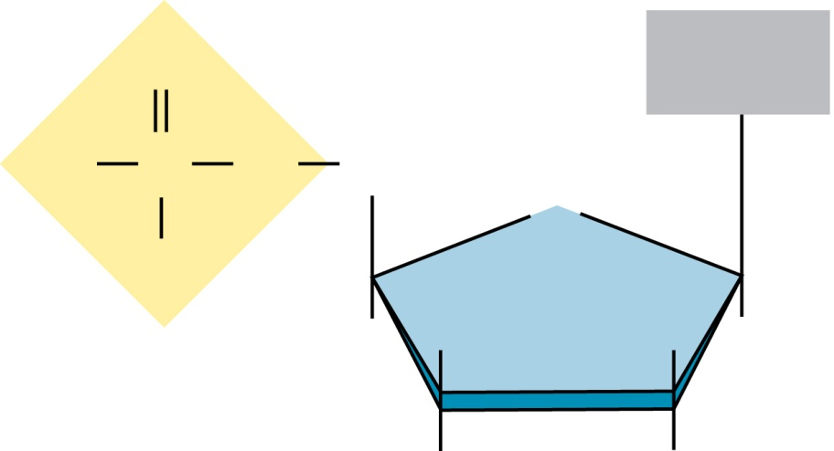
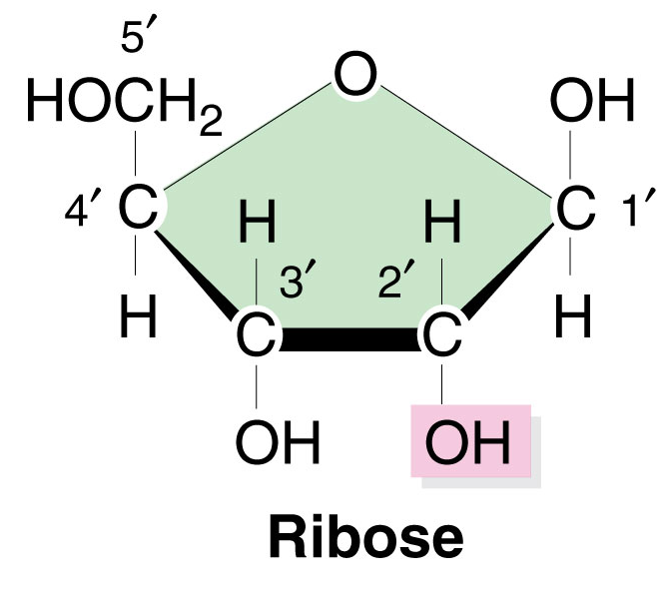
DNA is polymer of nucleotides
Purines
Pyrimidines
Nucleotide =
sugar-phosphate-base
4 bases:
adenine (A)
guanine (G)
cytosine (C)
thymine (T)
O
Base
O
P
O
CH₂
5′
O
O–
4′
1′
H
H
Phosphate
H
H
3′
2′
Pentose sugar
OH
H
Deoxyribose

Slide 5
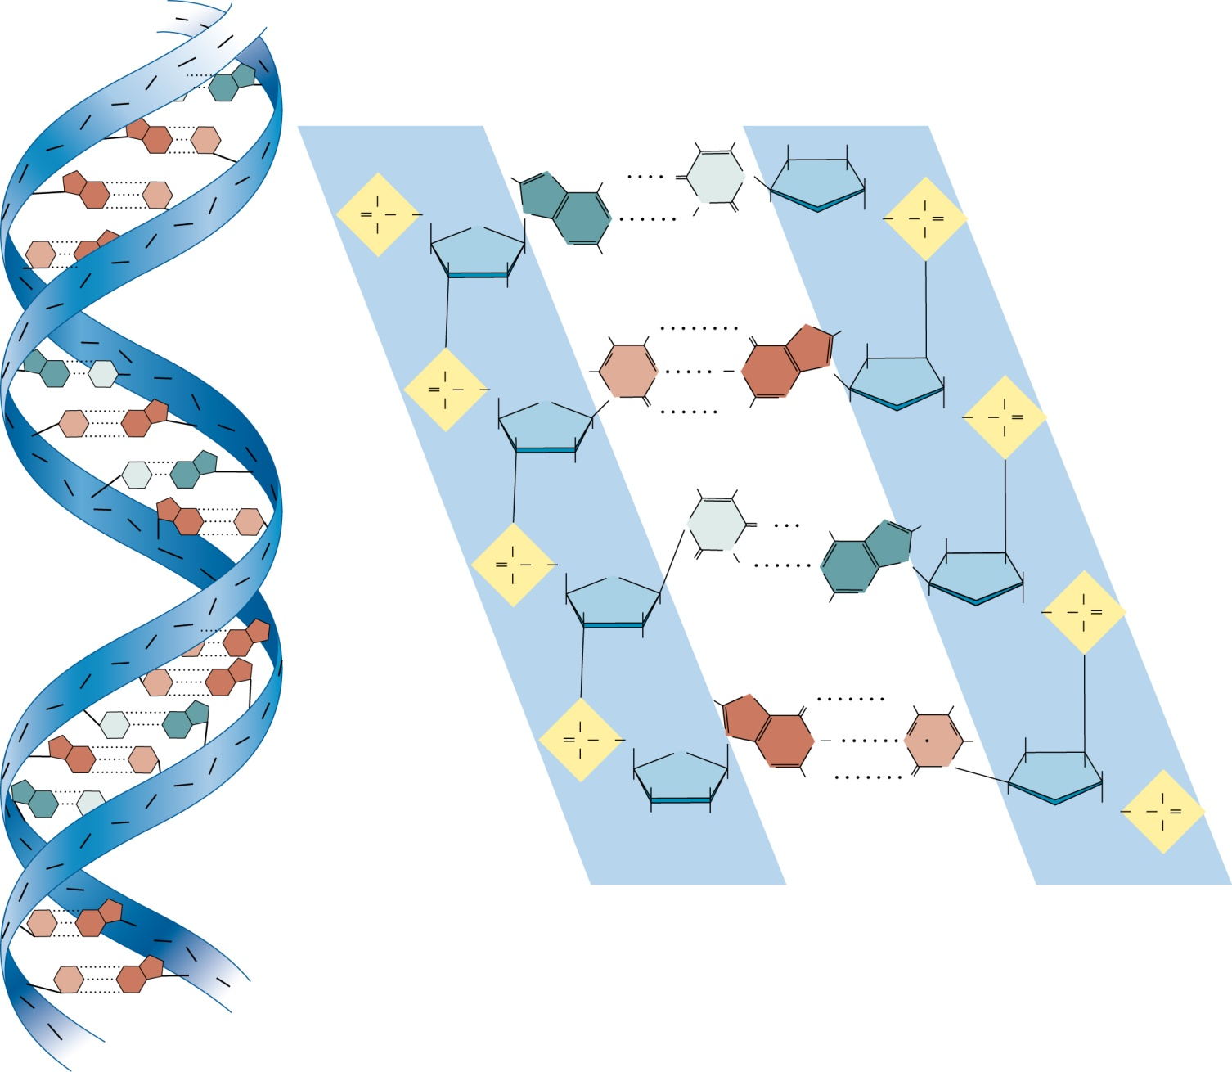
DNA structure
Each strand has direction 5’ to 3’
DNA strands are anti-parallel
5′
3′
P
Sugar & phosphate forms the backbone
Sugar & phosphate forms a spiral of two strands wound around each other known as “Double helix”
Base from “strand 1” meets the base from “strand 2” in the middle forms base pair
James Watson & Francis Crick (1953) determined the structure of DNA
P
S
P
P
S
A
S
5′ end
3′ end
BASE PAIRs
P
S
G
C
P
CH₃
H
H
HO
S
G
C
P
S
O
–
H
N
NH₂
T
N
H
H
H
O
–
S
O
P
O
CH₂
O
N
A
N
H
N
O
H
O
CH₂
O
P
O
C
P
O
–
N
O
S
P
S
H
H
H
H
H
P
S
H
P
S
H
NH₂
O
N
H
H
S
P
O
A
T
S
P
O
P
O
CH₂
H
C
N
H
N
G
N
H
H
H
O
–
C
G
S
O
–
O
N
O
H₂N
N
H
O
CH₂
O
P
O
S
P
H
H
H
H
O
P
T
A
S
H
H
CH₃
2 hydrogen bonds between T and A
S
P
G
C
P
N
T
H₂N
N
H
H
S
P
O
O
N
A
N
P
S
O
P
–
O
CH₂
O
H
N
H
H
H
O
–
S
P
O
H
H
H
H
H
N
H
O
CH₂
O
P
O
P
G
S
H
O
3.4 nm
P
S
C
G
P
S
P
O
H
N
H₂N
H
T
A
P
S
O
P
O
CH₂
N
G
N
H
N
C
H
H
S
G
C
S
O
–
O
N
NH₂
N
H
H
H
A
T
P
0.34 nm
H
H
H
H
O
H
O
O
–
S
P
S
O
H
H
CH₂
O
P
–
O
P
S
O
P
S
P
3′ end
5′ end
S
C
G
S
P
S
C
G
S
3 hydrogen bonds between T and A
P
5′
3′
2 nm

Slide 6
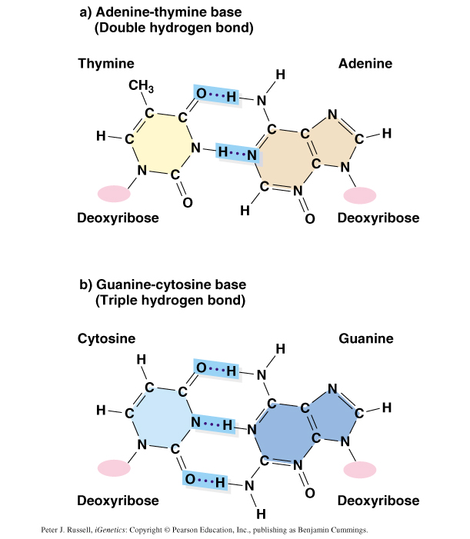
Hydrogen bonded DNA base pairs
Watson-Crick base pairing
A = T
T = A
G ≡ C
C ≡ G
Two H-bonds
Three H-bonds

Slide 7
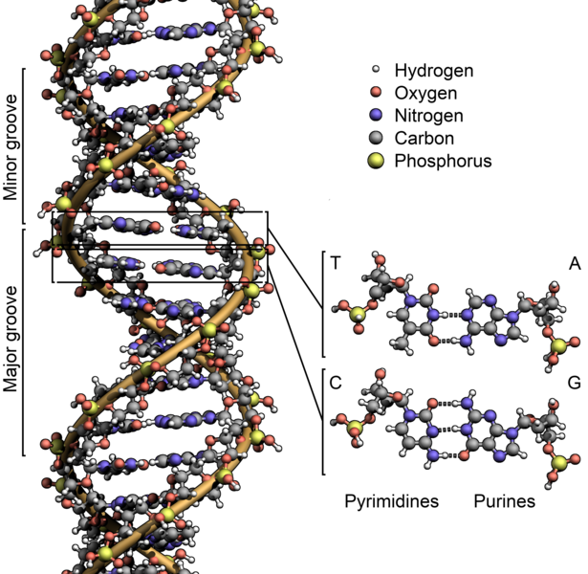
DNA structure: Major & minor groove

Slide 8
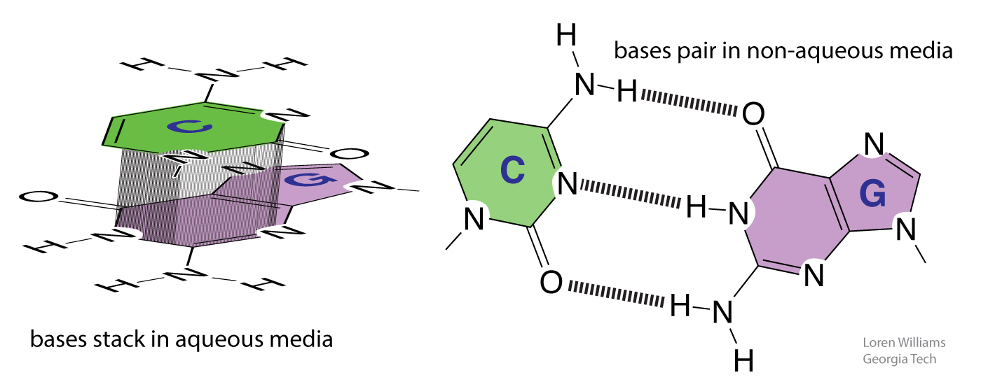
Forces that stabilize DNA structure
H-bond between bases of the complementary strand
Base-stacking: Stacking of aromatic rings next to each other: 𝛑-𝛑 interaction

Slide 9
Chemical nature of DNA
2 strands of nucleotides
Each strand has direction 5’ ➛ 3’, DNA strands are anti-parallel
DNA is written as per the
base of any one strand (5’)-AGGTCGTAGTCAATTCC-(3’)
COMPLEMENTARY strand
SEQUENCE will be: (3’)-TCCAGCATCAGTTAAGG-(5’)
Written as 5’-3’:
(5’)-GGAATTGACTACGACCT-(3’)

Slide 10
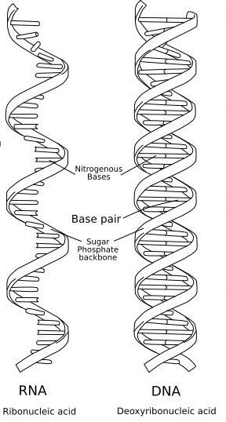
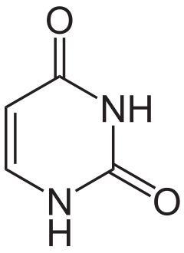
RNA
Purines
Ribose sugar
Phosphate group
One of 4 types of bases:
- Adenine
- Uracyl (only in RNA)
- Cytosine
- Guanine
Pyrimidines
CH₃
4
3
5
6
2
-OH at the #2 C
on the ribose,
vs. deoxyribose in DNA
1
uracil (U)

Slide 11
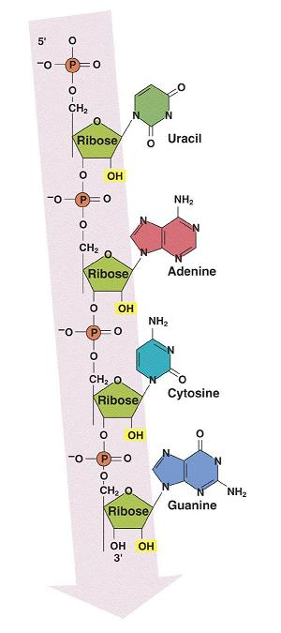
Chemical nature of RNA
5′
Direction
RNA is also polymer of nucleotides
RNA is different from DNA
RNA has a different sugar: ribose instead of deoxyribose
DNA has the nucleotide thymine (T), RNA has the nucleotide uracil (U).
RNA is single stranded molecule whereas DNA is double stranded; although RNA can form local double-strand
RNA is much more abundant than DNA
nucleotide
Sugar
(ribose)
3′

Slide 12
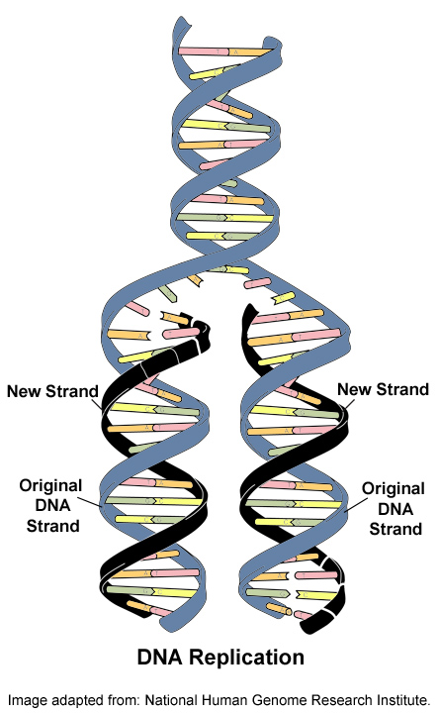
DNA synthesis is known as Replication
Two strand separate
Nucleotides match up with complementary bases
Nucleotides are joied by the enzyme, polymerase
Mutations occur when copying errors cause a change in the sequence of DNA nucleotide bases

Slide 13
DNA synthesis
O
O—P=O
O
I
I
I
O
O—P=O
O
G
O
O—P=O
O
I
I
I
I
I
I
CH2
DNA synthesis requires:
Deoxyribose nucleotide triphosphates
(ATP, GTP, CTP and TTP)
Enzyme: DNA polymerase
Template DNA strands
A
A
CH2
CH2
O
O—P=O
O
I
I
I
O
T
OH
II
I
II
I
CH2
O
⁻O—P—O—
O⁻
O
P—OH
O
II
I
II
I
I
I
I
H-O-H
O
⁻O—P—O—
OH
O
P—
OH
OH
O—P=O
O
⁻O—P=O
O
I
I
I
C
C
CH2
CH2
O
O
O—P=O
O
I
I
I
OH
OH
T
CH2
Nucleotides are joined by Phosphodiester bond

Slide 14
RNA synthesis is known as Transcription
DNA is copied or transcribed into RNA
Transcription requires:
Ribonucleotide triphosphates:
(ATP, GTP, CTP and UTP), sugar is ribose (not deoxyribose)
2. Enzyme: RNA polymerase
3. Template: one of the DNA strands

Slide 15
RNA synthesis is known as Transcription
DNA sequence one strand (5’)-AGGTCGTAGTCAATTCC-(3’)
COMPLEMENTARY strand (3’)-TCCAGCATCAGTTAAGG-(5’)
Sequence of the RNA will be. (5’)-AGGUCGUAGUCAAUUCC-(3’)
Transcription

Slide 16

Why make RNA? To make protein
DNA “stores” the genetic information
RNA “transmit” the genetic information
A large complex protein called RIBOSOME translate the genetic information from RNA to protein
RNA
polymerase
Ribosome
DNA
RNA
Protein

Slide 17
Central Dogma of Molecular Biology
Genetic information present in the nucleotide sequence of the DNA is “TRANSCRIBED” into nucleotide sequence of RNA
Genetic information present in the nucleotide sequence of the RNA is “TRANSLATED” into amino acid sequence of Protein
Information transfer only in one direction
DNA RNA Protein
Transcription Translation

Slide 18
Genetic code
1st position
(5’ end)
2nd position
U
C
A
G
3rd position
(3’ end)
Codon: set of 3 nucleotides that represents a particular amino acid
Each codon codes for a specific amino acid
Total Codon = 64
Stop codon = 3
61 codon for 20 amino acids
START codon = 1st amino acid
STOP codon = no amino acids
U
Phe
Phe
Leu
Leu
Ser
Ser
Ser
Ser
Tyr
Tyr
STOP
STOP
Cys
Cys
STOP
Trp
U
C
A
G
C
Leu
Leu
Leu
Leu
Pro
Pro
Pro
Pro
His
HIs
Gln
Gln
Arg
Arg
Arg
Arg
U
C
A
G
A
Ile
Ile
Ile
Met
Thr
Thr
Thr
Thr
Asn
Asn
Lys
Lys
Ser
Ser
Arg
Arg
U
C
A
G
G
Val
Val
Val
Val
Ala
Ala
Ala
Ala
Asp
Asp
Glu
Glu
Gly
Gly
Gly
Gly
U
C
A
G

Slide 19
Decoding genetic code
The Genetic Code: the language in which instructions for proteins are written
Translation: decoding the mRNA and assembling the protein
Codon: three nucleotide that “code” for 1 amino acid
Ex: Original coding strand of DNA (the actual gene):
5’ ATG GTC CCT AAT CCT 3’
Sequence of RNA (Transcript):
5’ AUG GUC CCU AAU CCU 3’
Sequence of RNA (Transcript):
Met – Val – Pro – Asn – Pro

Slide 20
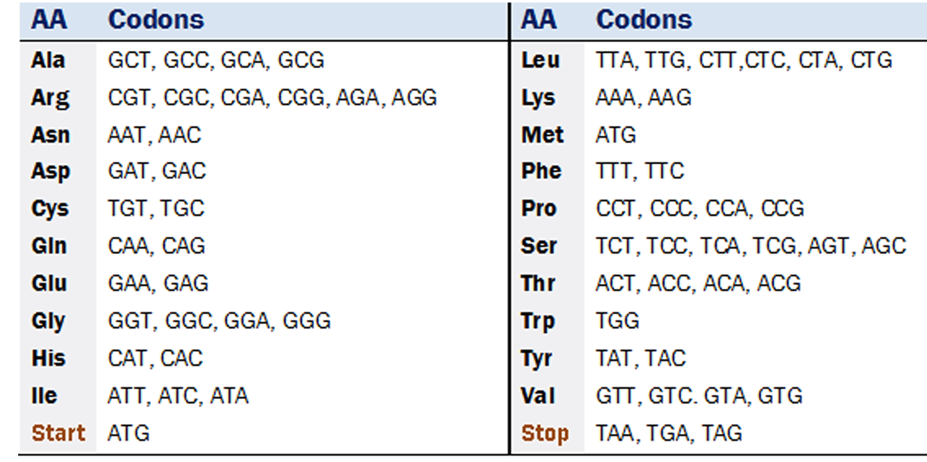
Genetic code
The code is linear
The code is triplet
The code is Universal
The code is Non-overlapping
The code is Unpunctuated
The code is Degenerate (or redundant): 61 codon for 20 amino acids

Slide 21
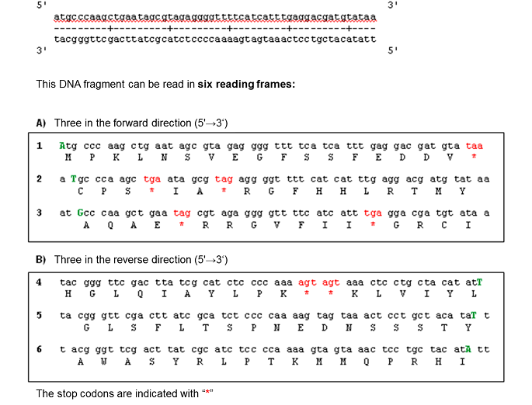
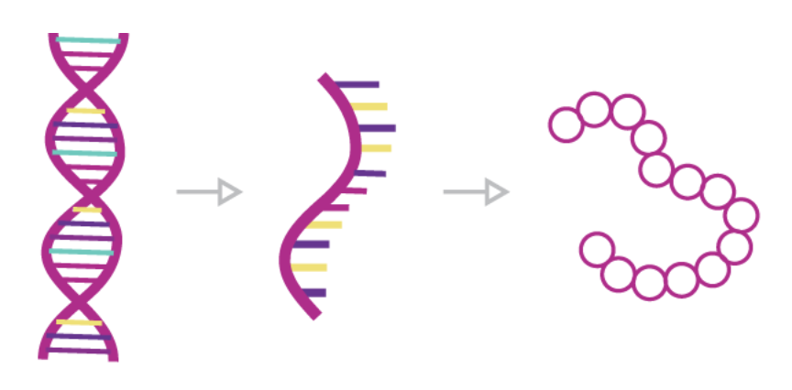
Decoding genetic code
Reading frame:
the series of nucleotides read in sets of 3 (codon)
Codon = THREE nucleotides
One Codon = One Aminoacid

Slide 22
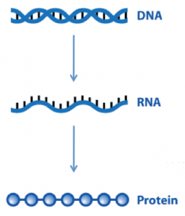
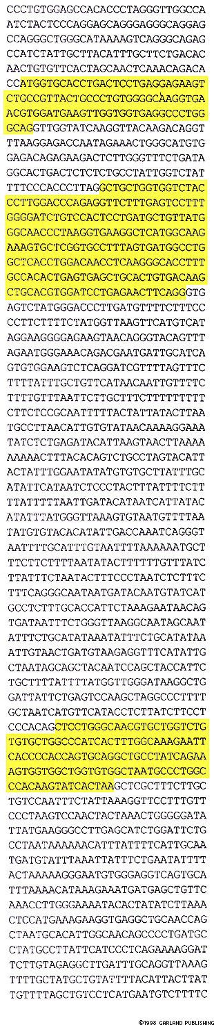
Genes encode proteins
RNA
Gene A
Protein A
AUGGTAGTTGATUCGTAAUGGTAGTTGATUCGTACCUUGAUGGTAGTTGATUCGTAAUGGTAGTTGATUCGTA
M-D-G-R-R-H-D-K-K-D-E-L
Human genome has 3.2 billion (3.2x10⁹) base pairs
Only about 3% of DNA encode ~ 30,000 genes
Is remaining DNA junk (?)
Gene B
RNA
Protein B
Gene C
Protein C
RNA
DNA

Slide 23
Three Types of RNAs
Messenger RNA (mRNA): copy of genetic information from DNA
Ribosomal RNA (rRNA): structural component of Ribosome
Transfer RNA (tRNA): transport amino acids to proteins

Slide 24
How proteins are made
TRANSLATIONAL COMPONENTS
1. Ribosome (made of Ribosomal RNA (rRNA) & Protein)
2. Messenger RNA (mRNA)
Transfer RNAs (tRNAs)
Amino Acids

Slide 25
Ribosome
+
rRNA
50 Proteins
+
rRNA
33 Proteins
Two subunits composed of protein and ribosomal RNA (rRNA)
The rRNA is a structural component of the ribosome subunits
Venki Ramakrishnan got Chemistry Nobel prize 2009 for solving structure
of Ribosome

Slide 26
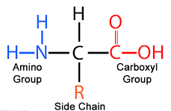
Transfer RNA (tRNA)
Amino acid is joined here
tRNAs typically are 70-80 nucleotides in length
They all have a clover leaf (STEM-LOOP) due to base pairing
Anti-codon: 3 nucleotide sequence in tRNA that recognize and base-pair with 3 nucleotide codon in mRNA via H-bonding
Har Gobind Khorana got Chemistry Nobel prize 1968 for solving structure of tRNA
3’
5’
tRNA
ANTICODON
3’
5’
AAG
5’- UUC UUG AAG AAC AAA CCG - 3’
mRNA
CODON

Slide 27
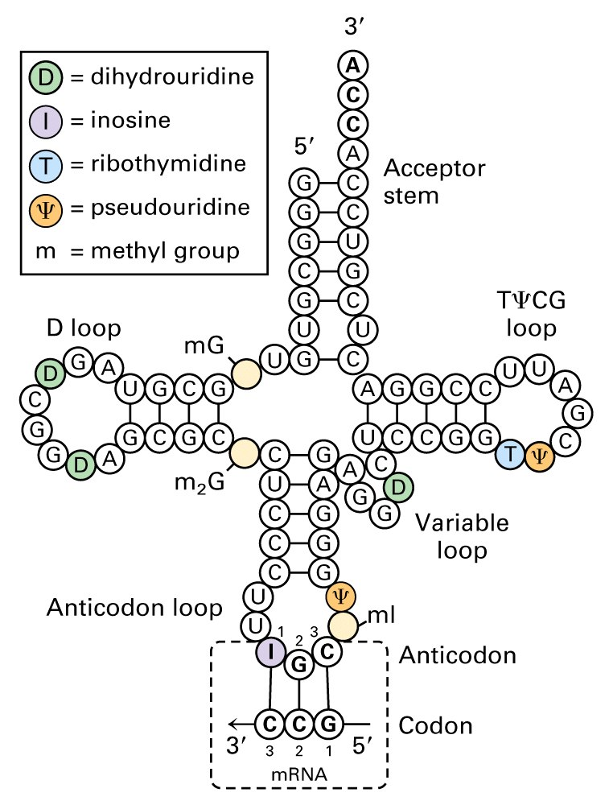
Transfer RNA (tRNA)
aa
Amino acid
Phe
Trp
Phe – tRNA
Met – tRNA _{M}
3’
5’
3’
5’
AAG
ACC
Anticodon
Recognize Phe codon
Anticodon
Recognize Trp codon

Slide 28
Translation
tRNA “transport” amino acid to
ribosome
Ala
Peptide bond forms
Ala
tRNA leaves Ribosome
Leu
Ribosome moves to next codon
Leu
Phe
Another tRNA brings another amino acid to ribosome
Trp
Phe
Trp
Ala
UUC
UGG
CUG

Slide 29
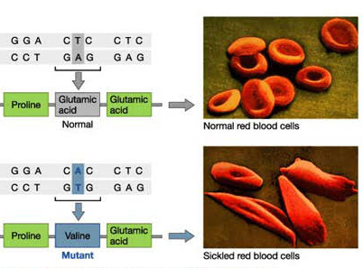
Mutation
SUBSTITUTION OF A SINGLE BASE: ABNORMAL proteins
Sickle haemoglobin (HbS) which is different from the normal haemoglobin (HbA) and arise due to substitution mutation
Tri-nucleotide REPEATS, e.g., CGG repeats many times in fragile X syndrome
POINT MUTATION within a coding
sequence changes Glu to Val

Slide 30
Mutation
DELETION OF A SINGLE BASE: Frameshift mutation
1st position
(5’ end)
2nd position
U
C
A
G
3rd position
(3’ end)
U
Phe
Phe
Leu
Leu
Ser
Ser
Ser
Ser
Tyr
Tyr
STOP
STOP
Cys
Cys
STOP
Trp
U
C
A
G
codon #
5 6 7
CCU
Pro
GAG
Glu
GAG
Glu
GAG
Glu
Normal
C
Leu
Leu
Leu
Leu
Pro
Pro
Pro
Pro
His
HIs
Gln
Gln
Arg
Arg
Arg
Arg
U
C
A
G
CCU
Pro
GGG
Gly
AGG
Arg
Mutant
A
Ile
Ile
Ile
Met
Thr
Thr
Thr
Thr
Asn
Asn
Lys
Lys
Ser
Ser
Arg
Arg
U
C
A
G
G
Val
Val
Val
Val
Ala
Ala
Ala
Ala
Asp
Asp
Glu
Glu
Gly
Gly
Gly
Gly
U
C
A
G

Slide 31
Genome data and Bioinformatics
An enormous amount of DNA sequence information is available from genome sequencing and sequencing of cloned genes.
This data is stored in data banks such as
GenBank at National Institute of Health (NIH). Bethesda, USA
EMBL Sequence Data Base at the European Molecular Biology Laboratory, Heidelberg, Germany.
Sanger Institute, Hinxton, United Kingdom
Scientists working in the area of bioinformatics use this data to find genes, analyze their properties

Slide 32
Question
1. Anti-codon is found in
A. mRNA
B. rRNA
C. tRNA
D. all of the above
2. Which is the right depiction of DNA?
3. Which of the following is correct statement about central dogma of molecular biology
A. DNA —> RNA —> Protein
B. Protein —> DNA —> RNA
C. RNA —> Protein —>DNA
D. DNA —> RNA —> DNA
5’ 3’
3’ 5’
5’ 5’
3’ 3’

Slide 33
Questions
1. What is the length of DNA if it has total of 10⁸ Watson-Crick base pairs?
A. 34 cm
B. 34 mm
C. 34 m
D. none of the above
2. If a DNA has a sequence of 5'-AACCGATACA-3', what would be the complementary strand sequence in 5' to 3' direction?
A. ACATAGCCAA
B. TGTATCGGTT
C. TTGGCTATGT
D. AACCGATACA
3. There are 64 codons and there are only 20 amino acids. How many codon(s) do not code any amino acids at all?
A. 44
B. 4
C. 3
D. 0

Slide 34
The start of the human β-globin gene reads 5ʹ-ATGGTGCAC-3ʹ.
What is the sequence of the mRNA for this segment of DNA?
What would be the Amino acids coded by this sequence?

